Slide 1
Week 2 - CYBS 3743: Cyberforensics Fundamental
January 30th 2025
Sungbo Jung

Slide 2

Learner’s Ethics
Do the Right Thing!
Images from https://boardagenda.com/

Slide 3
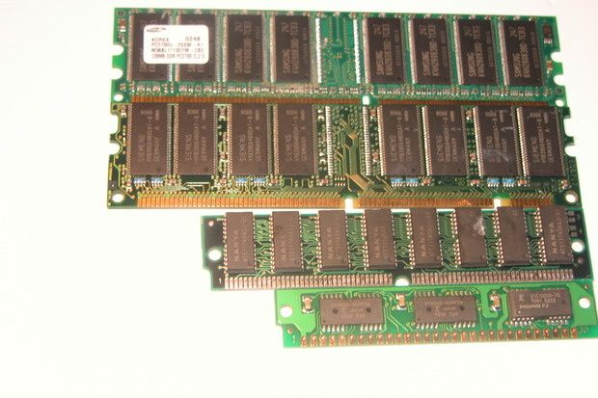
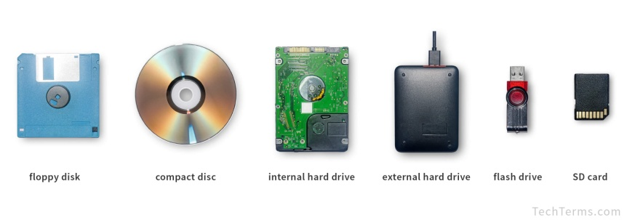
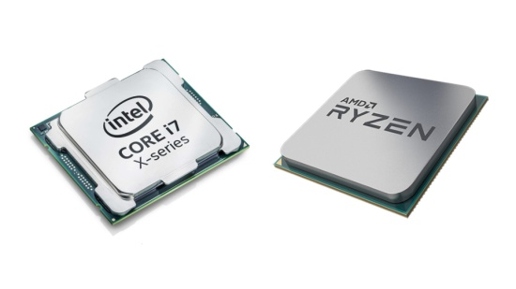
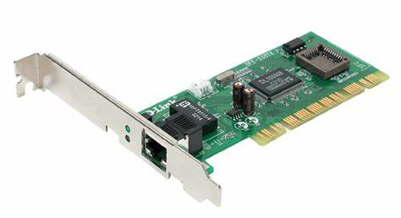
Computer Components
S/W
Data
Socket
User
Application
File
Kernel (O/S)
H/W
RAM
Volatile Memory
Disk Drives
Non-Volatile Memory
CPU
NIC

Slide 4
Flash Cards (a.k.a. Post It)
What do you remember from last lecture?

Slide 5
evidence COLLECTION procedure
Preparation
Securing the Scene
Identification
Documentation
Collection
Preservation
Chain of Custody

Slide 6
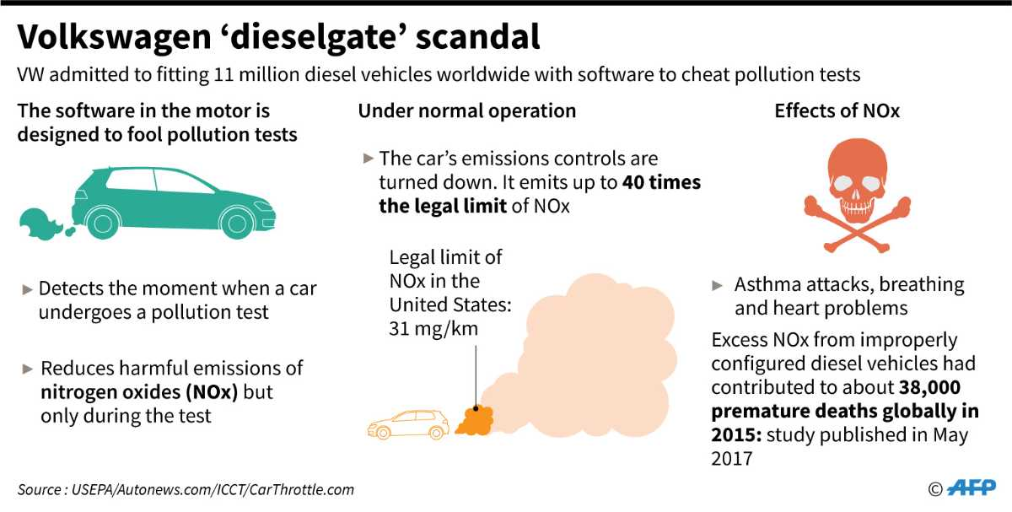
Data Capturing
Live System
Collect the data during operation
Capture the volatile data on the actual scene

Slide 7
Evidence Collection Guideline
RFC 3227
Order of Volatility
Prioritize data that is most likely to be lost first.
CPU cache, RAM, network connections, and running processes.
Less (No) contamination

Slide 8
Importance of Memory
RAM
Main components for computing devices
When power down, it will lose the data (Volatility)
Encrypted data will run as decrypted inside memory
We can verify the hidden process

Slide 9
Memory Capturing Tools
Dumpit
Winpmem
AccessData-FTK Imager

Slide 10
TYPE of Evidence
System Information
System Time
Network Connection
Process List
Logon Users
Loaded DLL List
Etc (command history, open port in application, open file in application, routing table, and so on)

Slide 11


